Slide 1
Hydrogen As Fuel
Presented
By
Shabir Ahmed Bhat (Assistant Professor Chemistry)
Govt. Degree College(Boys) Anantnag

Slide 2
Hydrogen as a fuel
hydrogen is the most abundant element in the universe
Occurs mainly in bound form , water and hydrocarbons.
Has the potential to become the fuel for the
future generation
Ability to harvest on renewable energy source
Inexhaustibility and independence from foreign control

Slide 3
Some old saying in the context of hydrogen
I believe that water will one day be employed as fuel, the hydrogen and oxygen which constitute it, used singly or together, will furnish an inexhaustible source of heat and light, of an intensity of which coal is not capable. I believe then that when the deposits of coal are exhausted, we shall heat and warm ourselves with water.
“Water will be the coal of the future."
Jules Vernes (1870) "L´île mystérieuse”

Slide 4
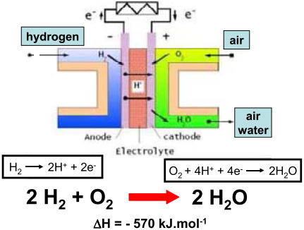
Hydrogen economy drivers
Hydrogen has more energy
per unit mass than any other
fuel
Enables truly
Zero emission vehicles.
Potentially can be mass
Produced and commercialized
for passenger vehicles and air craft.

Slide 5
Calorific value comparison
fuel | Calorific value(Kj/Kg)
carbon | 34080
gasoline | 47300
charcoal | 29600
diesel | 44800
methane | 55,530
petrol | 48000
wood | 14400-17400
Alcohol | 30,000
Hydrogen | 141790

Slide 6
Hydrogen production
Reforming fossil fuels
Electrolysis of water
High temperature electrolysis
Biological processes
Very common in nature
Experiment in laboratories

Slide 7
Steam reforming
From any hydrocarbon
Natural gas typically used
water and hydrocarbon mixed at high temperature(700-1100⁰C)
Steam reacts with methane
CH4 + H2O→CO + 3H2
Difficult to motivate investment in technology

Slide 8
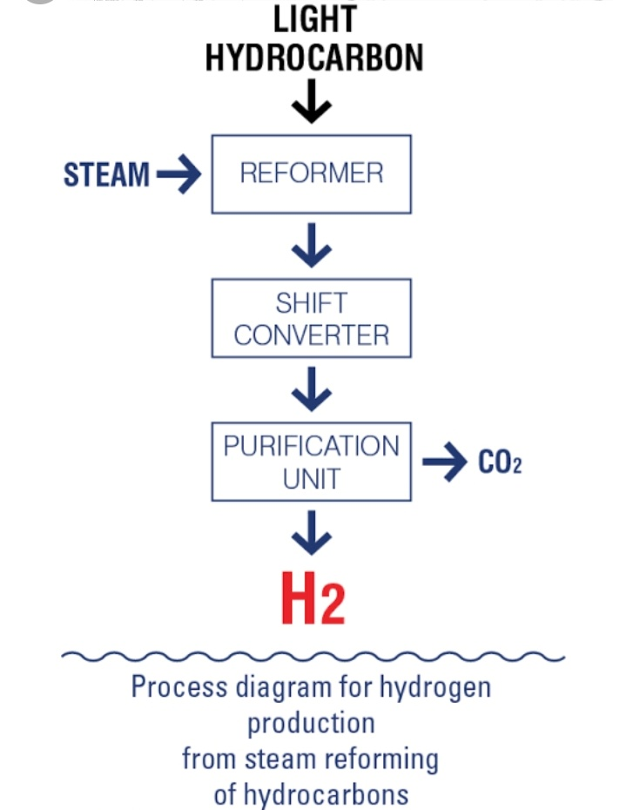
Hydrogen Steam reforming

Slide 9
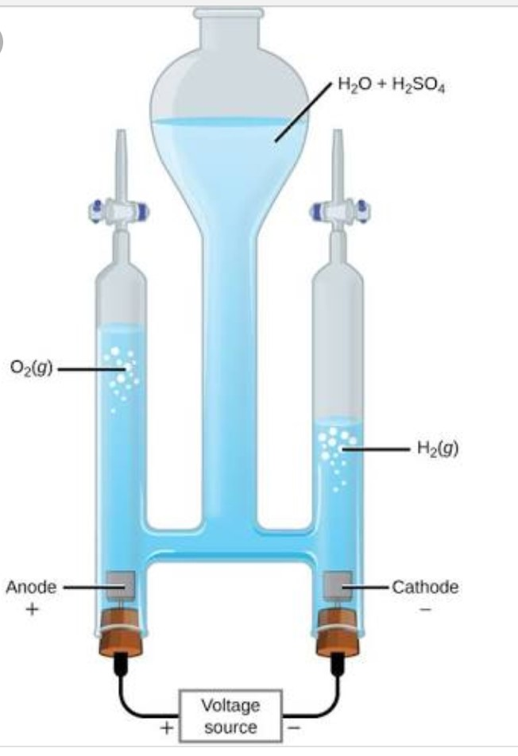
Electrolysis of water
Use electricity to split
Water into H₂ and O₂
2H₂O → 2H₂ +O₂

Slide 10
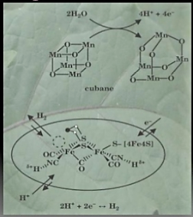
Biological H₂ creation
Nature has very simple
method to split water
Scientists are working to
mimic these processes in the
lab

Slide 11
Common requirements for hydrogen storage
Weight and volume
Cost
Efficiency
Safety
Life cycle
Environmental impact

Slide 12
Storage methods
Physical storage:-
Liquefaction ,
compression and
physi-sorption
Chemical storage:-
metal hydrides
complex hydrides

Slide 13
Challenges in storage
For a given volume hydrogen contains a small amount of useable energy than other fuels such as natural gas and gasoline
On weight basis, hydrogen has nearly three times the energy content of gasoline however on volume basis the situation is reversed

Slide 14
Compressed storage
Involves pressurizing of gaseous sample at 150 bar
Gravimetrically and volumetrically inefficient
Most common storage system

Slide 15
Working set up

Slide 16
Cryogenic
Storage at low temperature(-253⁰C)
Technologically challenging
Boils at 20.15 K temperature
Gravimetrically inefficient but volumetrically efficient
Costly to condense

Slide 17
Liquid hydrogen tank

Slide 18
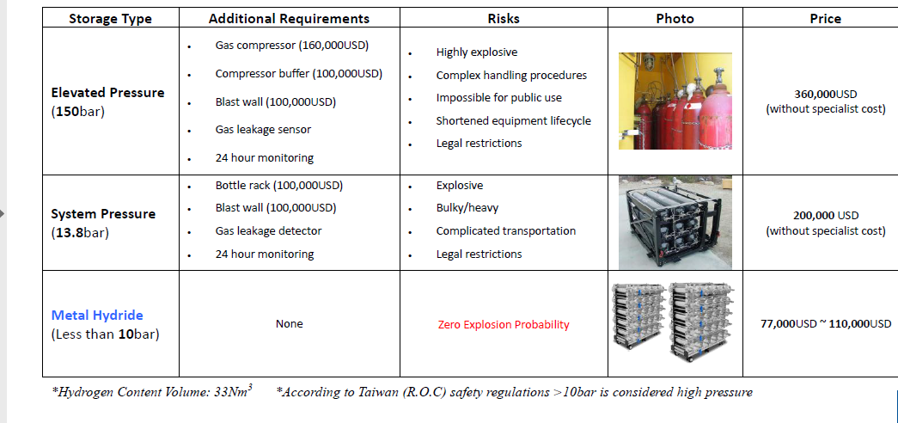
Cost comparison by storage type

Slide 19
Chemical storage
It involves storage as metal hydride
Hydrogen adsorbed under low pressure
gravimetrically and volumetrically efficient
15 times smaller in volume than 150bar high pressure tank
Hydrogen released at elevated temperatures

Slide 20
Chemical vs physical methods

Slide 21
Fuel cells
fuel cells are electrochemical cells like batteries that convert chemical energy of a fuel directly and very efficiently into electricity with water and heat as its byproduct
2H₂ + O₂ → 2H2O+ heat and light
Unlike a battery, fuel cell does not run down or require re-charging , it will produce energy as long as the fuel is supplied

Slide 22
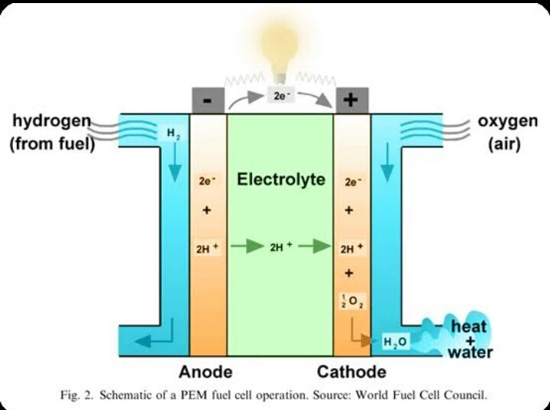
Fuel cell diagram

Slide 23
Safety implications
Hydrogen is highly inflammable gas
High flame temperature
Small molecular size promotes leaks and diffusion
Negative joule thomson-cofficient, leaking gas warms and may spontaneously ignite

Slide 24
challenges
Infra-structure : large scale manufacturing processes and support infra-structures , such as trained personal are not yet available
The size and weight of current fuel cell system must be reduced to attain market acceptance , especially with automobiles

